Slide 1
What is Cache Eviction Strategies ?
Caching is a technique to make applications lightning fast, reduce database load, and improve user experience.
But, cache memory is limited - you can’t store everything.
So, how do you decide which items to keep and which ones to evict when space runs out?
This is where cache eviction strategies come into play. They determine which items are removed to make room for new ones.
Top 7 Cache Eviction Strategies
Least Recently Used (LRU)
Least Frequently Used (LFU)
First In, First Out (FIFO)
Random Replacement (RR)
Most Recently Used (MRU)
Time to Live (TTL)
Two-Tiered Caching

Slide 2
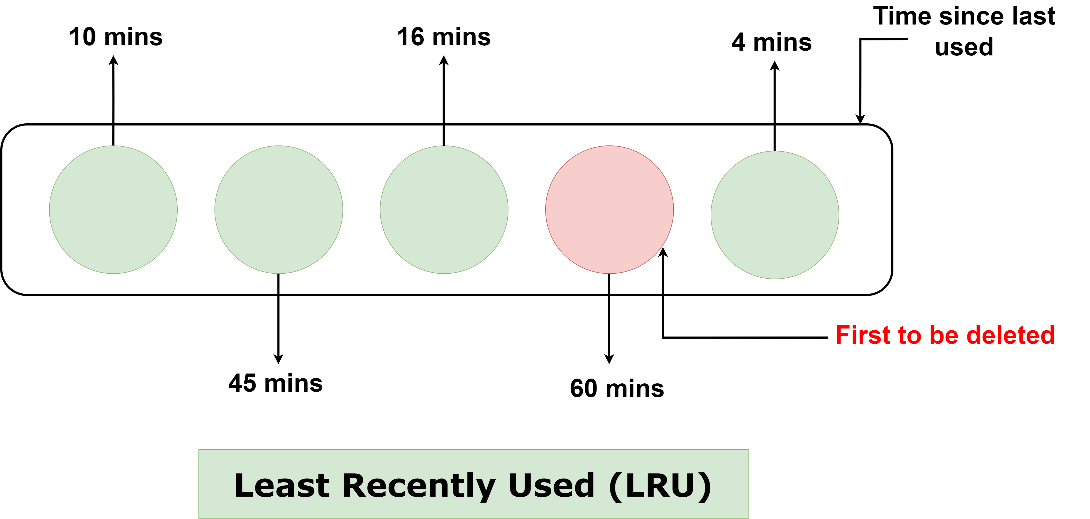
1. Least Recently Used (LRU)
LRU evicts the item that hasn’t been used for the longest time. The idea is simple: if you haven’t accessed an item in a while, it’s less likely to be accessed again soon.
How it Works
Access Tracking -> Cache Hit (Item Found in Cache) -> Cache Miss (Item Not Found in Cache) -> Eviction
Pros
Intuitive: Easy to understand and widely adopted.
Efficient: Keeps frequently accessed items in the cache.
Optimized for Real-World Usage: Matches many access patterns, such as web browsing and API calls.
Cons
Metadata Overhead: Tracking usage order can consume additional memory.
Performance Cost: For large caches, maintaining the access order may introduce computational overhead.
Not Adaptive: Assumes past access patterns will predict future usage, which may not always hold true.

Slide 3

2. Least Frequently Used (LFU)
LFU evicts the item with the lowest access frequency. It assumes that items accessed less frequently in the past are less likely to be accessed in the future. Unlike LRU, which focuses on recency, LFU emphasizes frequency of access.
How it Works
Track Access Frequency -> Cache Hit (Item Found in Cache) -> Cache Miss (Item Not Found in Cache) -> Eviction
Pros
Efficient for Predictable Patterns: Retains frequently accessed data, which is often more relevant.
Highly Effective for Popular Data: Works well in scenarios with clear "hot" items.
Cons
High Overhead: Requires additional memory to track frequency counts.
Slower Updates: Tracking and updating frequency can slow down operations.
Not Adaptive: May keep items that were frequently accessed in the past but are no longer relevant.

Slide 4
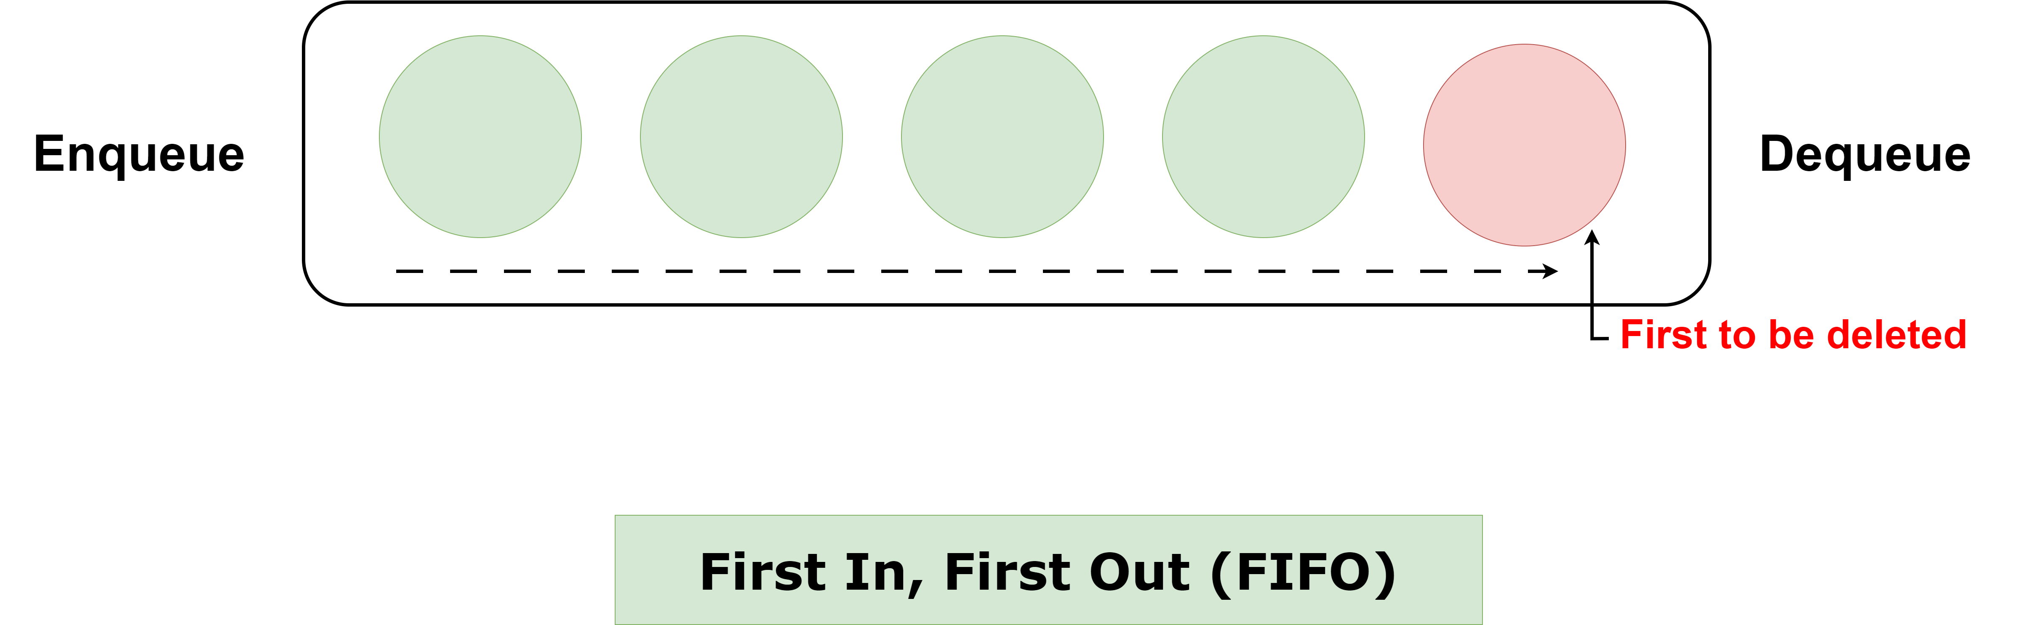
3. First In, First Out (FIFO)
FIFO evicts the item that was added first, regardless of how often it’s accessed. FIFO operates under the assumption that items added earliest are least likely to be needed as the cache fills up.
How it Works
Item Insertion -> Cache Hit (Item Found in Cache) -> Cache Miss (Item Not Found in Cache) -> Eviction
Pros
Simple to Implement: FIFO is straightforward and requires minimal logic.
Low Overhead: No need to track additional metadata like access frequency or recency.
Deterministic Behavior: Eviction follows a predictable order.
Cons
Ignores Access Patterns: Items still in frequent use can be evicted, reducing cache efficiency.
Suboptimal for Many Use Cases: FIFO is rarely ideal in modern systems where recency and frequency matter.
May Waste Cache Space: If old but frequently used items are evicted, the cache loses its utility.

Slide 5
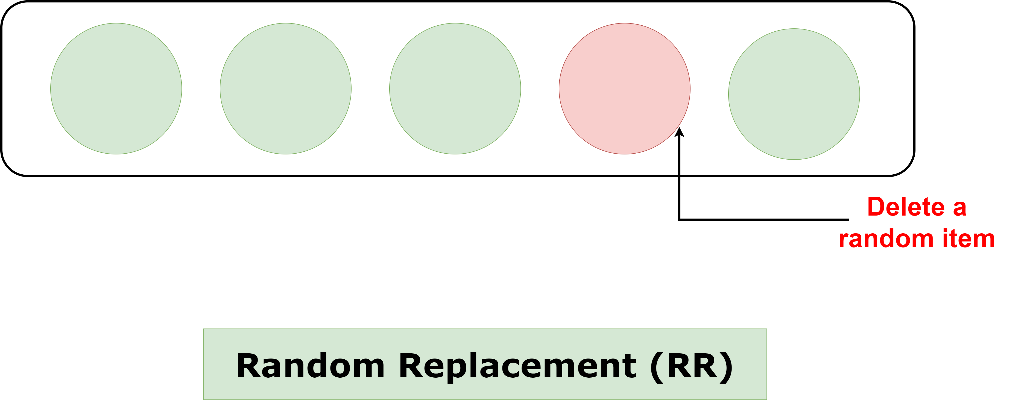
4. Random Replacement (RR)
RR cache eviction strategy is the simplest of all: when the cache is full, it evicts a random item to make space for a new one. It doesn't track recency, frequency, or insertion order, making it a lightweight approach with minimal computational overhead.
How it Works
Item Insertion -> Cache Hit (Item Found in Cache) -> Cache Miss (Item Not Found in Cache) -> Eviction
Pros
Simple to Implement: No need for metadata like access frequency or recency.
Low Overhead: Computational and memory requirements are minimal.
Fair for Unpredictable Access Patterns: Avoids bias toward recency or frequency, which can be useful in some scenarios.
Cons
Unpredictable Eviction: A frequently used item might be evicted, reducing cache efficiency.
Inefficient for Stable Access Patterns: Doesn’t adapt well when certain items are consistently accessed.
High Risk of Poor Cache Hit Rates: Random eviction often leads to suboptimal retention of important items.

Slide 6

5. Most Recently Used (MRU)
MRU is the opposite of Least Recently Used (LRU). In MRU, the item that was accessed most recently is the first to be evicted when the cache is full. The idea behind MRU is that the most recently accessed item is likely to be a temporary need and won’t be accessed again soon, so evicting it frees up space for potentially more valuable data.
How it Works
Item Insertion -> Cache Hit (Item Found in Cache) -> Cache Miss (Item Not Found in Cache) -> Eviction
Pros
Effective in Specific Scenarios: Retains older data, which might be more valuable in certain workloads.
Simple Implementation: Requires minimal metadata.
Cons
Suboptimal for Most Use Cases: MRU assumes recent data is less valuable, which is often untrue for many applications.
Poor Hit Rate in Predictable Patterns: Fails in scenarios where recently accessed data is more likely to be reused.
Rarely Used in Practice: Limited applicability compared to other strategies like LRU or LFU.

Slide 7
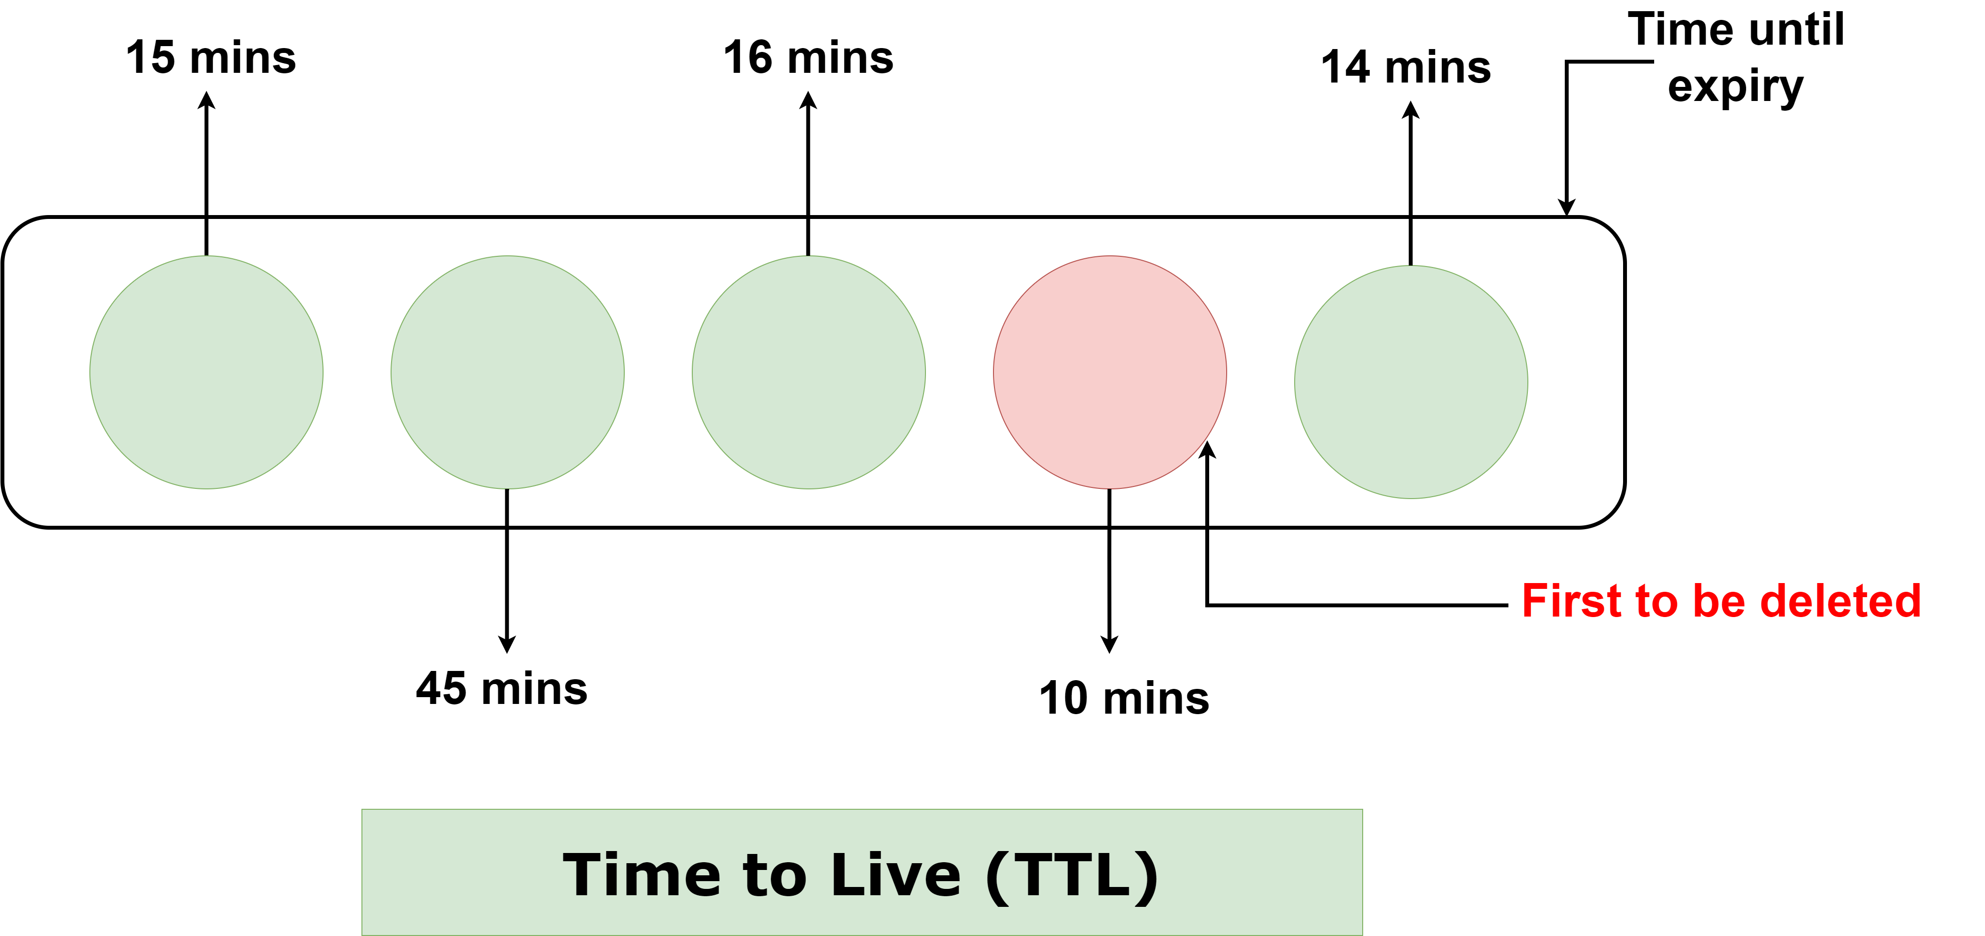
6. Time to Live (TTL)
TTL is a cache eviction strategy where each cached item is assigned a fixed lifespan. Once an item’s lifespan expires, it is automatically removed from the cache, regardless of access patterns or frequency. This ensures that cached data remains fresh and prevents stale data from lingering in the cache indefinitely.
How it Works
Item Insertion -> Cache Access (Hit or Miss) -> Eviction
Pros
Ensures Freshness: Automatically removes stale data, ensuring only fresh items remain in the cache.
Simple to Configure: TTL values are easy to assign during cache insertion.
Low Overhead: No need to track usage patterns or access frequency.
Prevents Memory Leaks: Stale data is cleared out systematically, avoiding cache bloat.
Cons
Fixed Lifespan: Items may be evicted prematurely even if they are frequently accessed.
Wasteful Eviction: Items that haven’t expired but are still irrelevant occupy cache space.
Limited Flexibility: TTL doesn’t adapt to dynamic workloads or usage patterns.

Slide 8
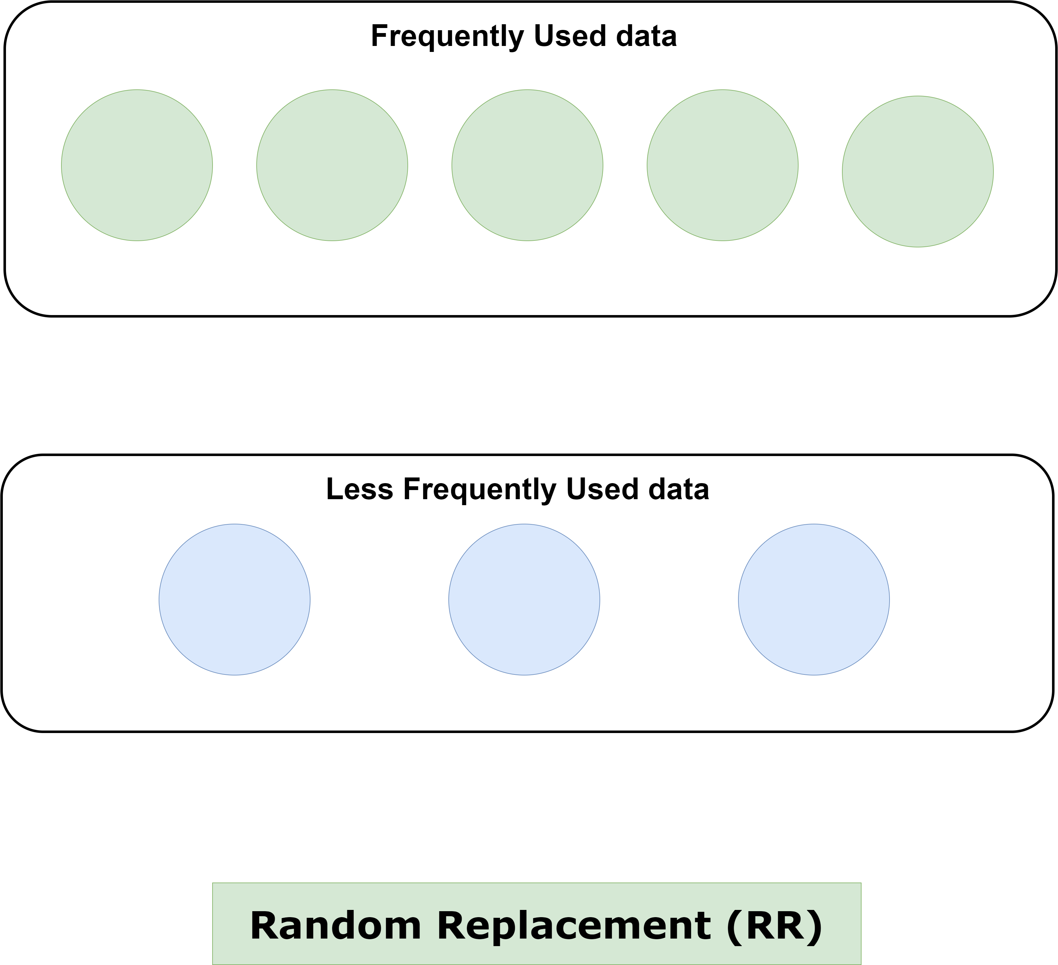
7. Two-Tiered Caching
Two-Tiered Caching combines two layers of cache—usually a local cache (in-memory) and a remote cache (distributed or shared). The local cache serves as the first layer (hot cache), providing ultra-fast access to frequently used data, while the remote cache acts as the second layer (cold cache) for items not found in the local cache but still needed relatively quickly.
How it Works
Local Cache (First Tier) -> Remote Cache (Second Tier)
Pros
Ultra-Fast Access: Local cache provides near-instantaneous response times for frequent requests.
Scalable Storage: Remote cache adds scalability and allows data sharing across multiple servers.
Reduces Database Load: Two-tiered caching significantly minimizes calls to the backend database.
Fault Tolerance: If the local cache fails, the remote cache acts as a fallback.
Cons
Complexity: Managing two caches introduces more overhead, including synchronization and consistency issues.
Stale Data: Inconsistent updates between tiers may lead to serving stale data.
Increased Latency for Remote Cache Hits: Accessing the second-tier remote cache is slower than the local cache.

